Slide 1
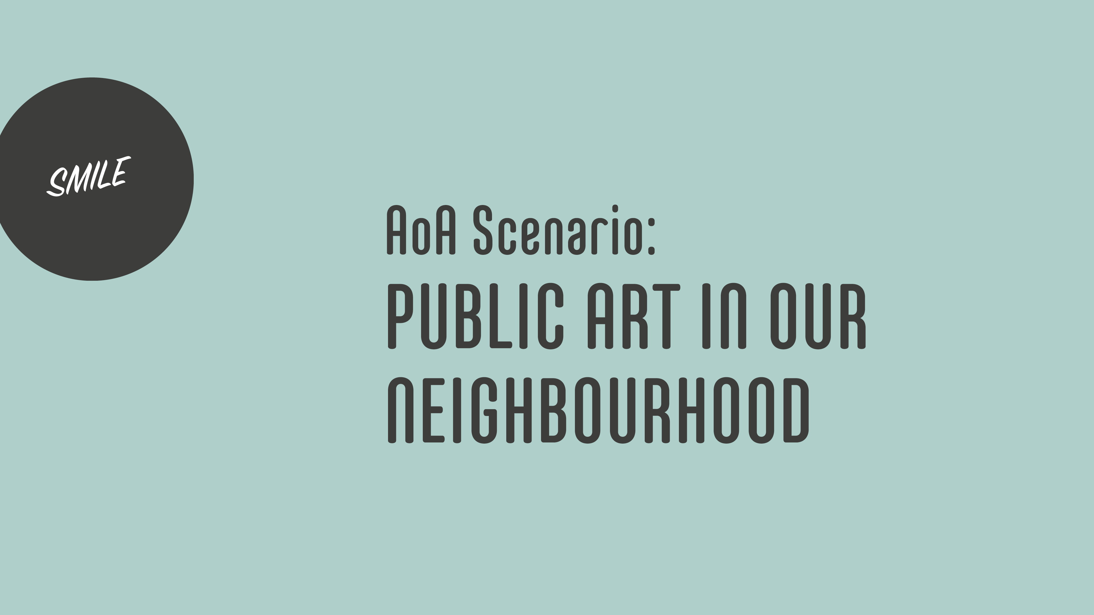

Slide 2


Slide 3
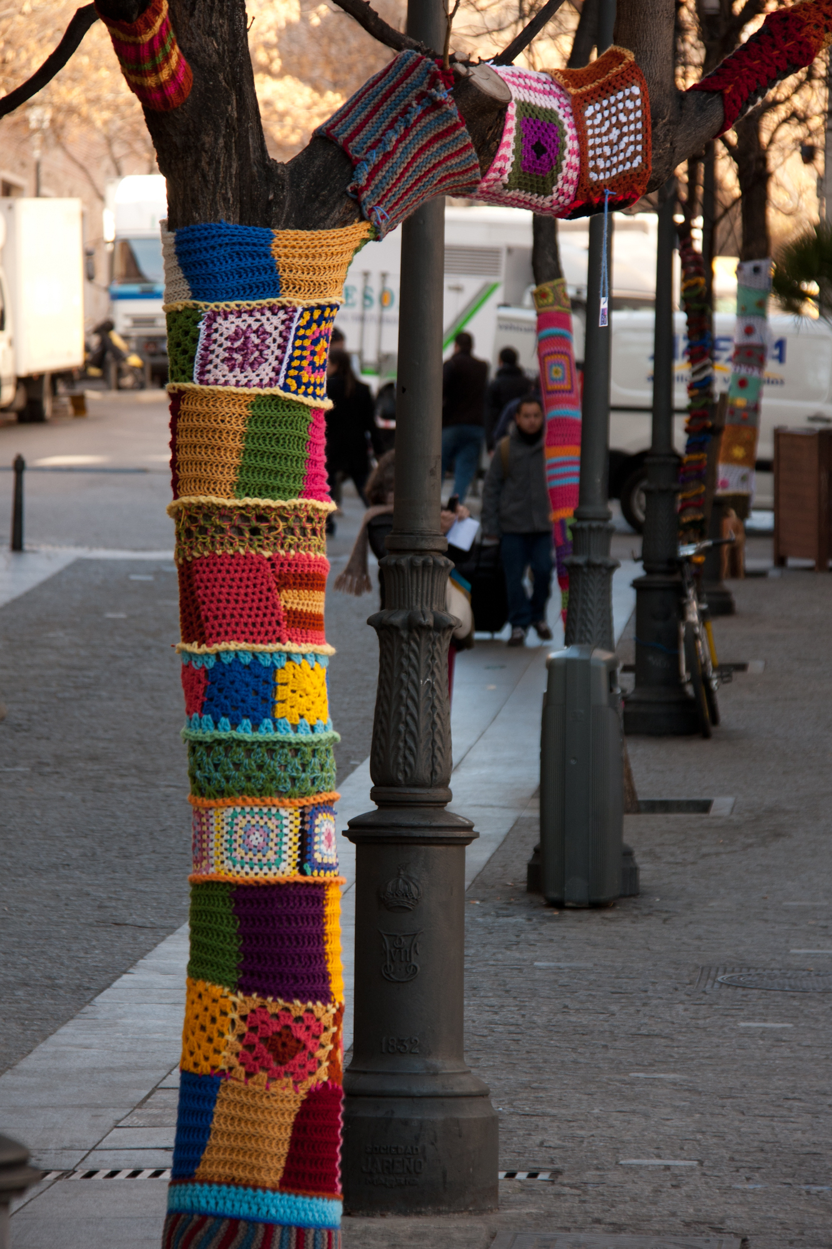
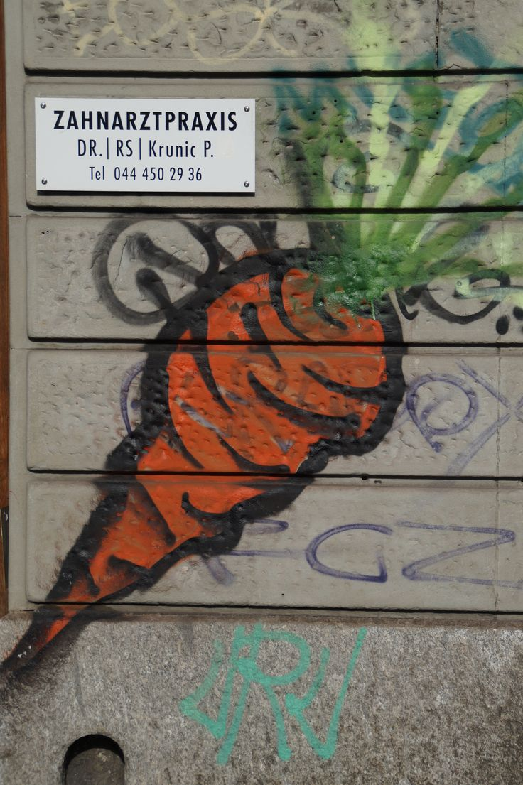
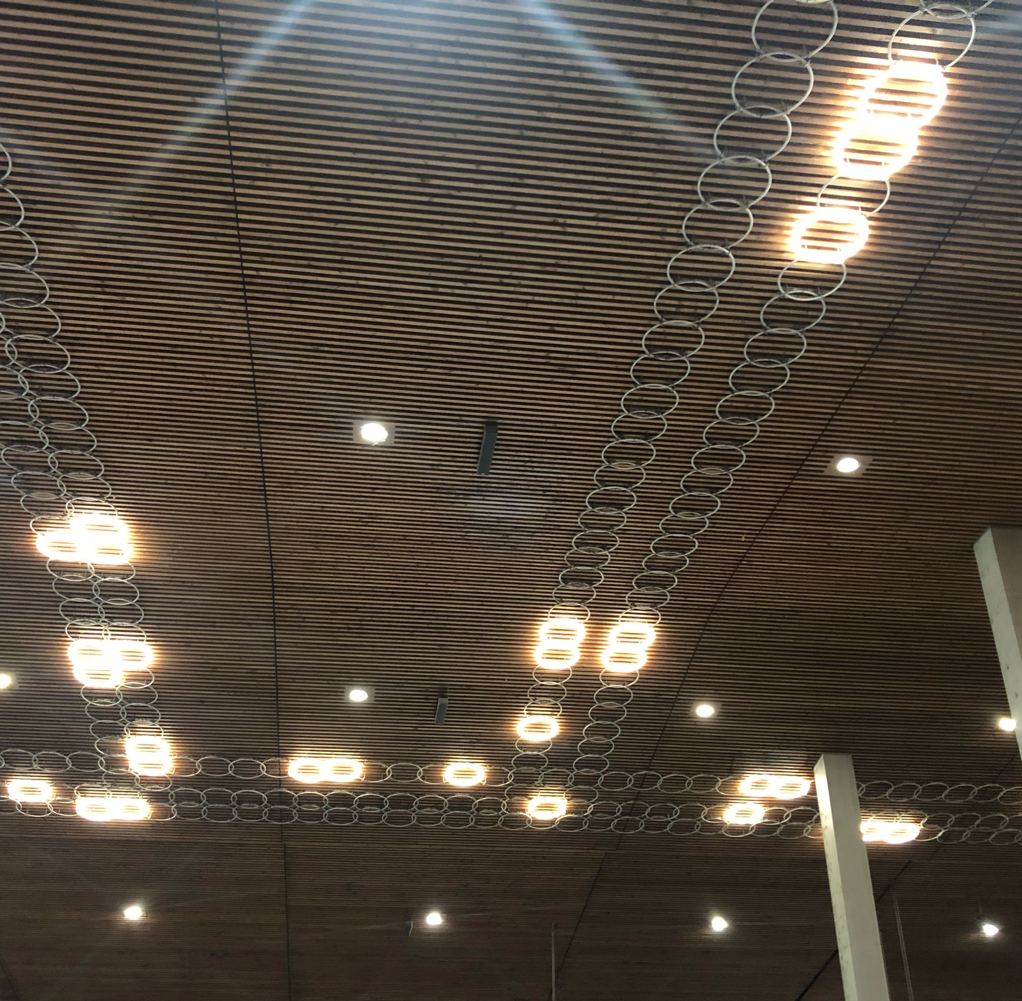
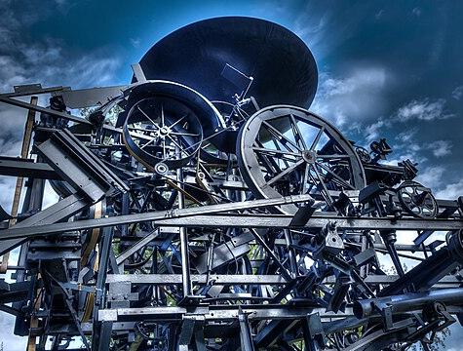
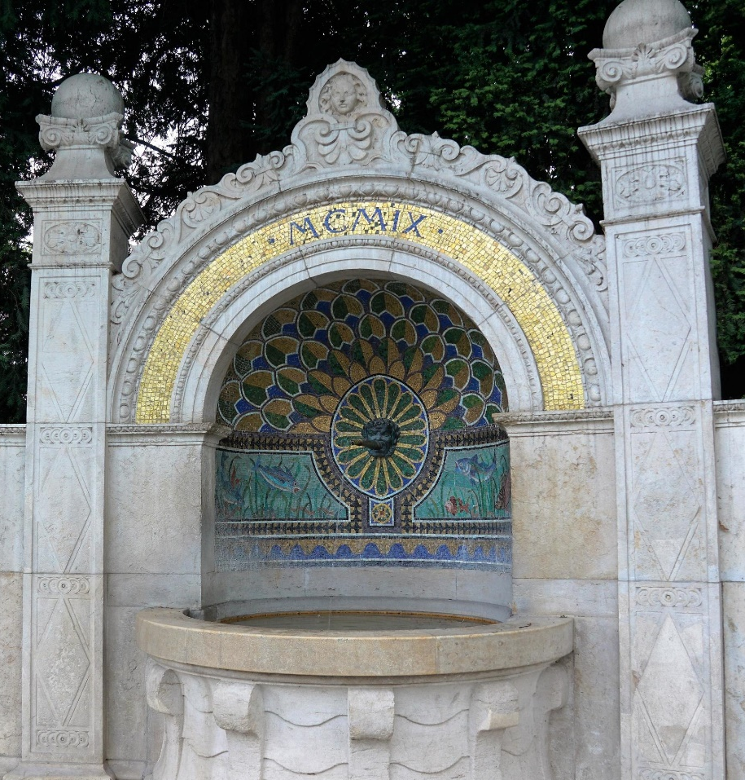
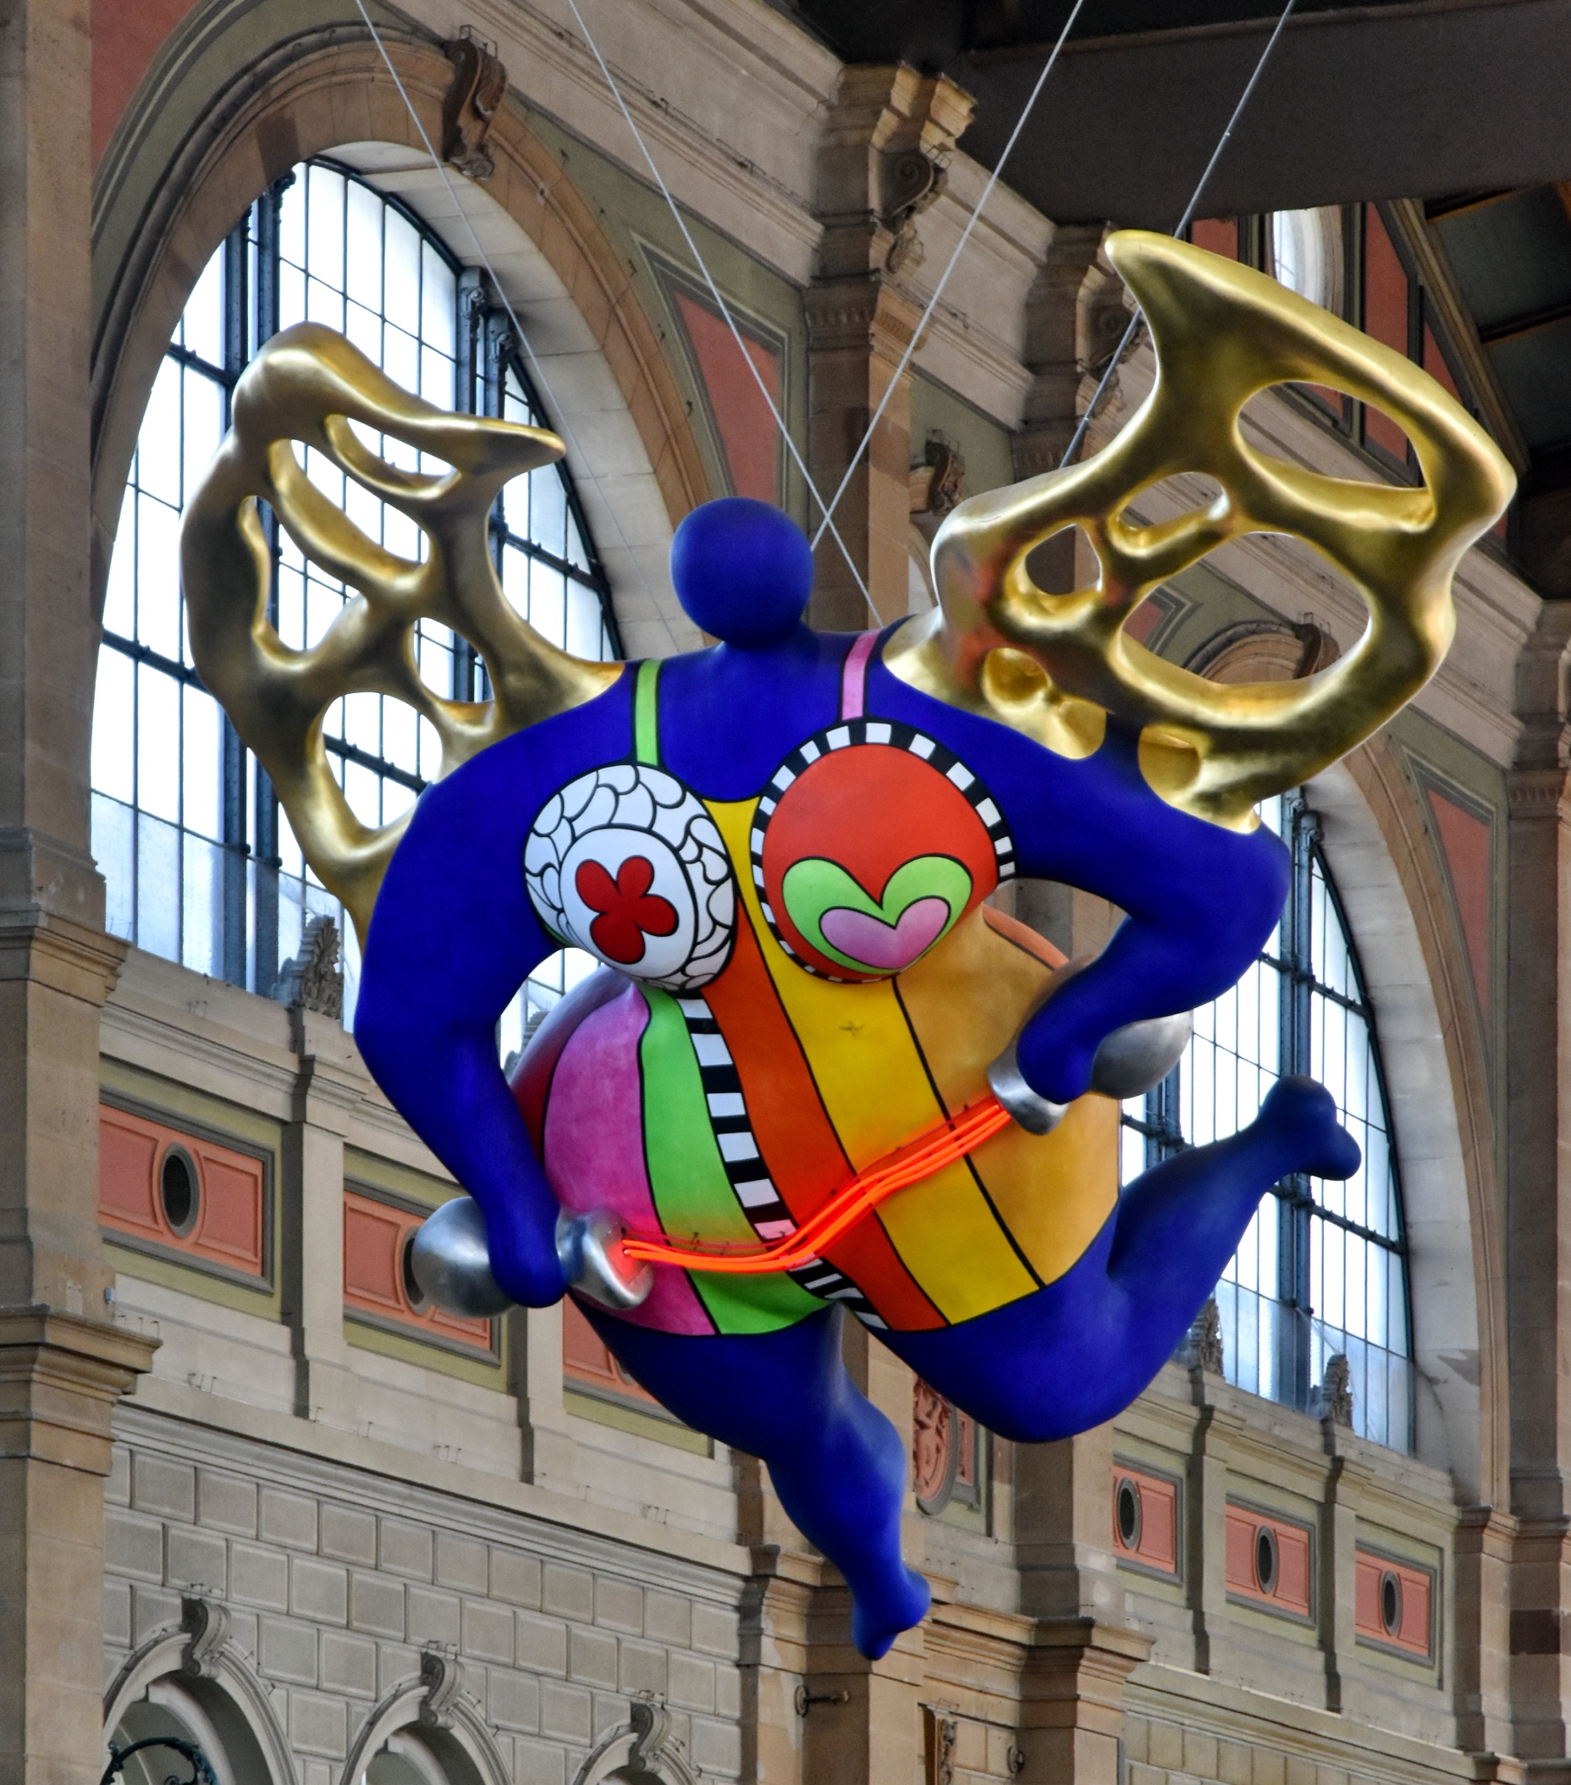
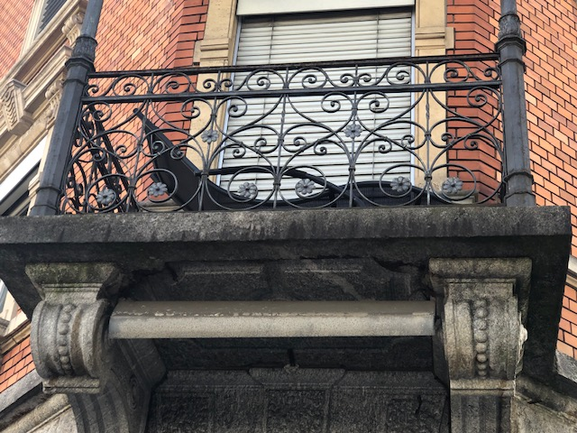
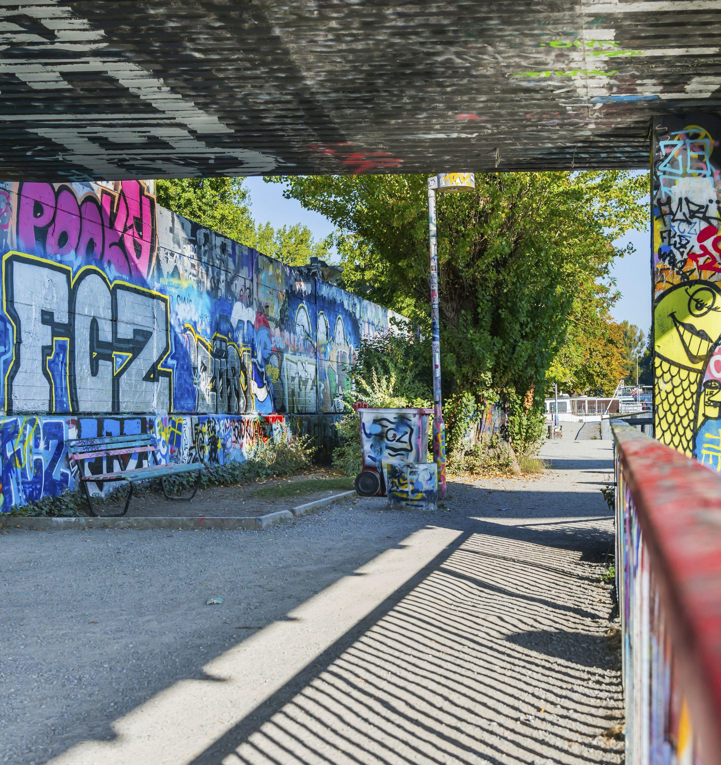
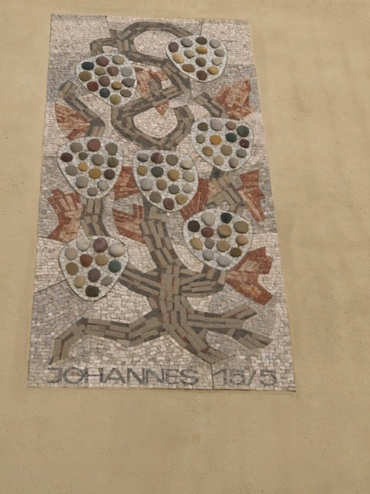
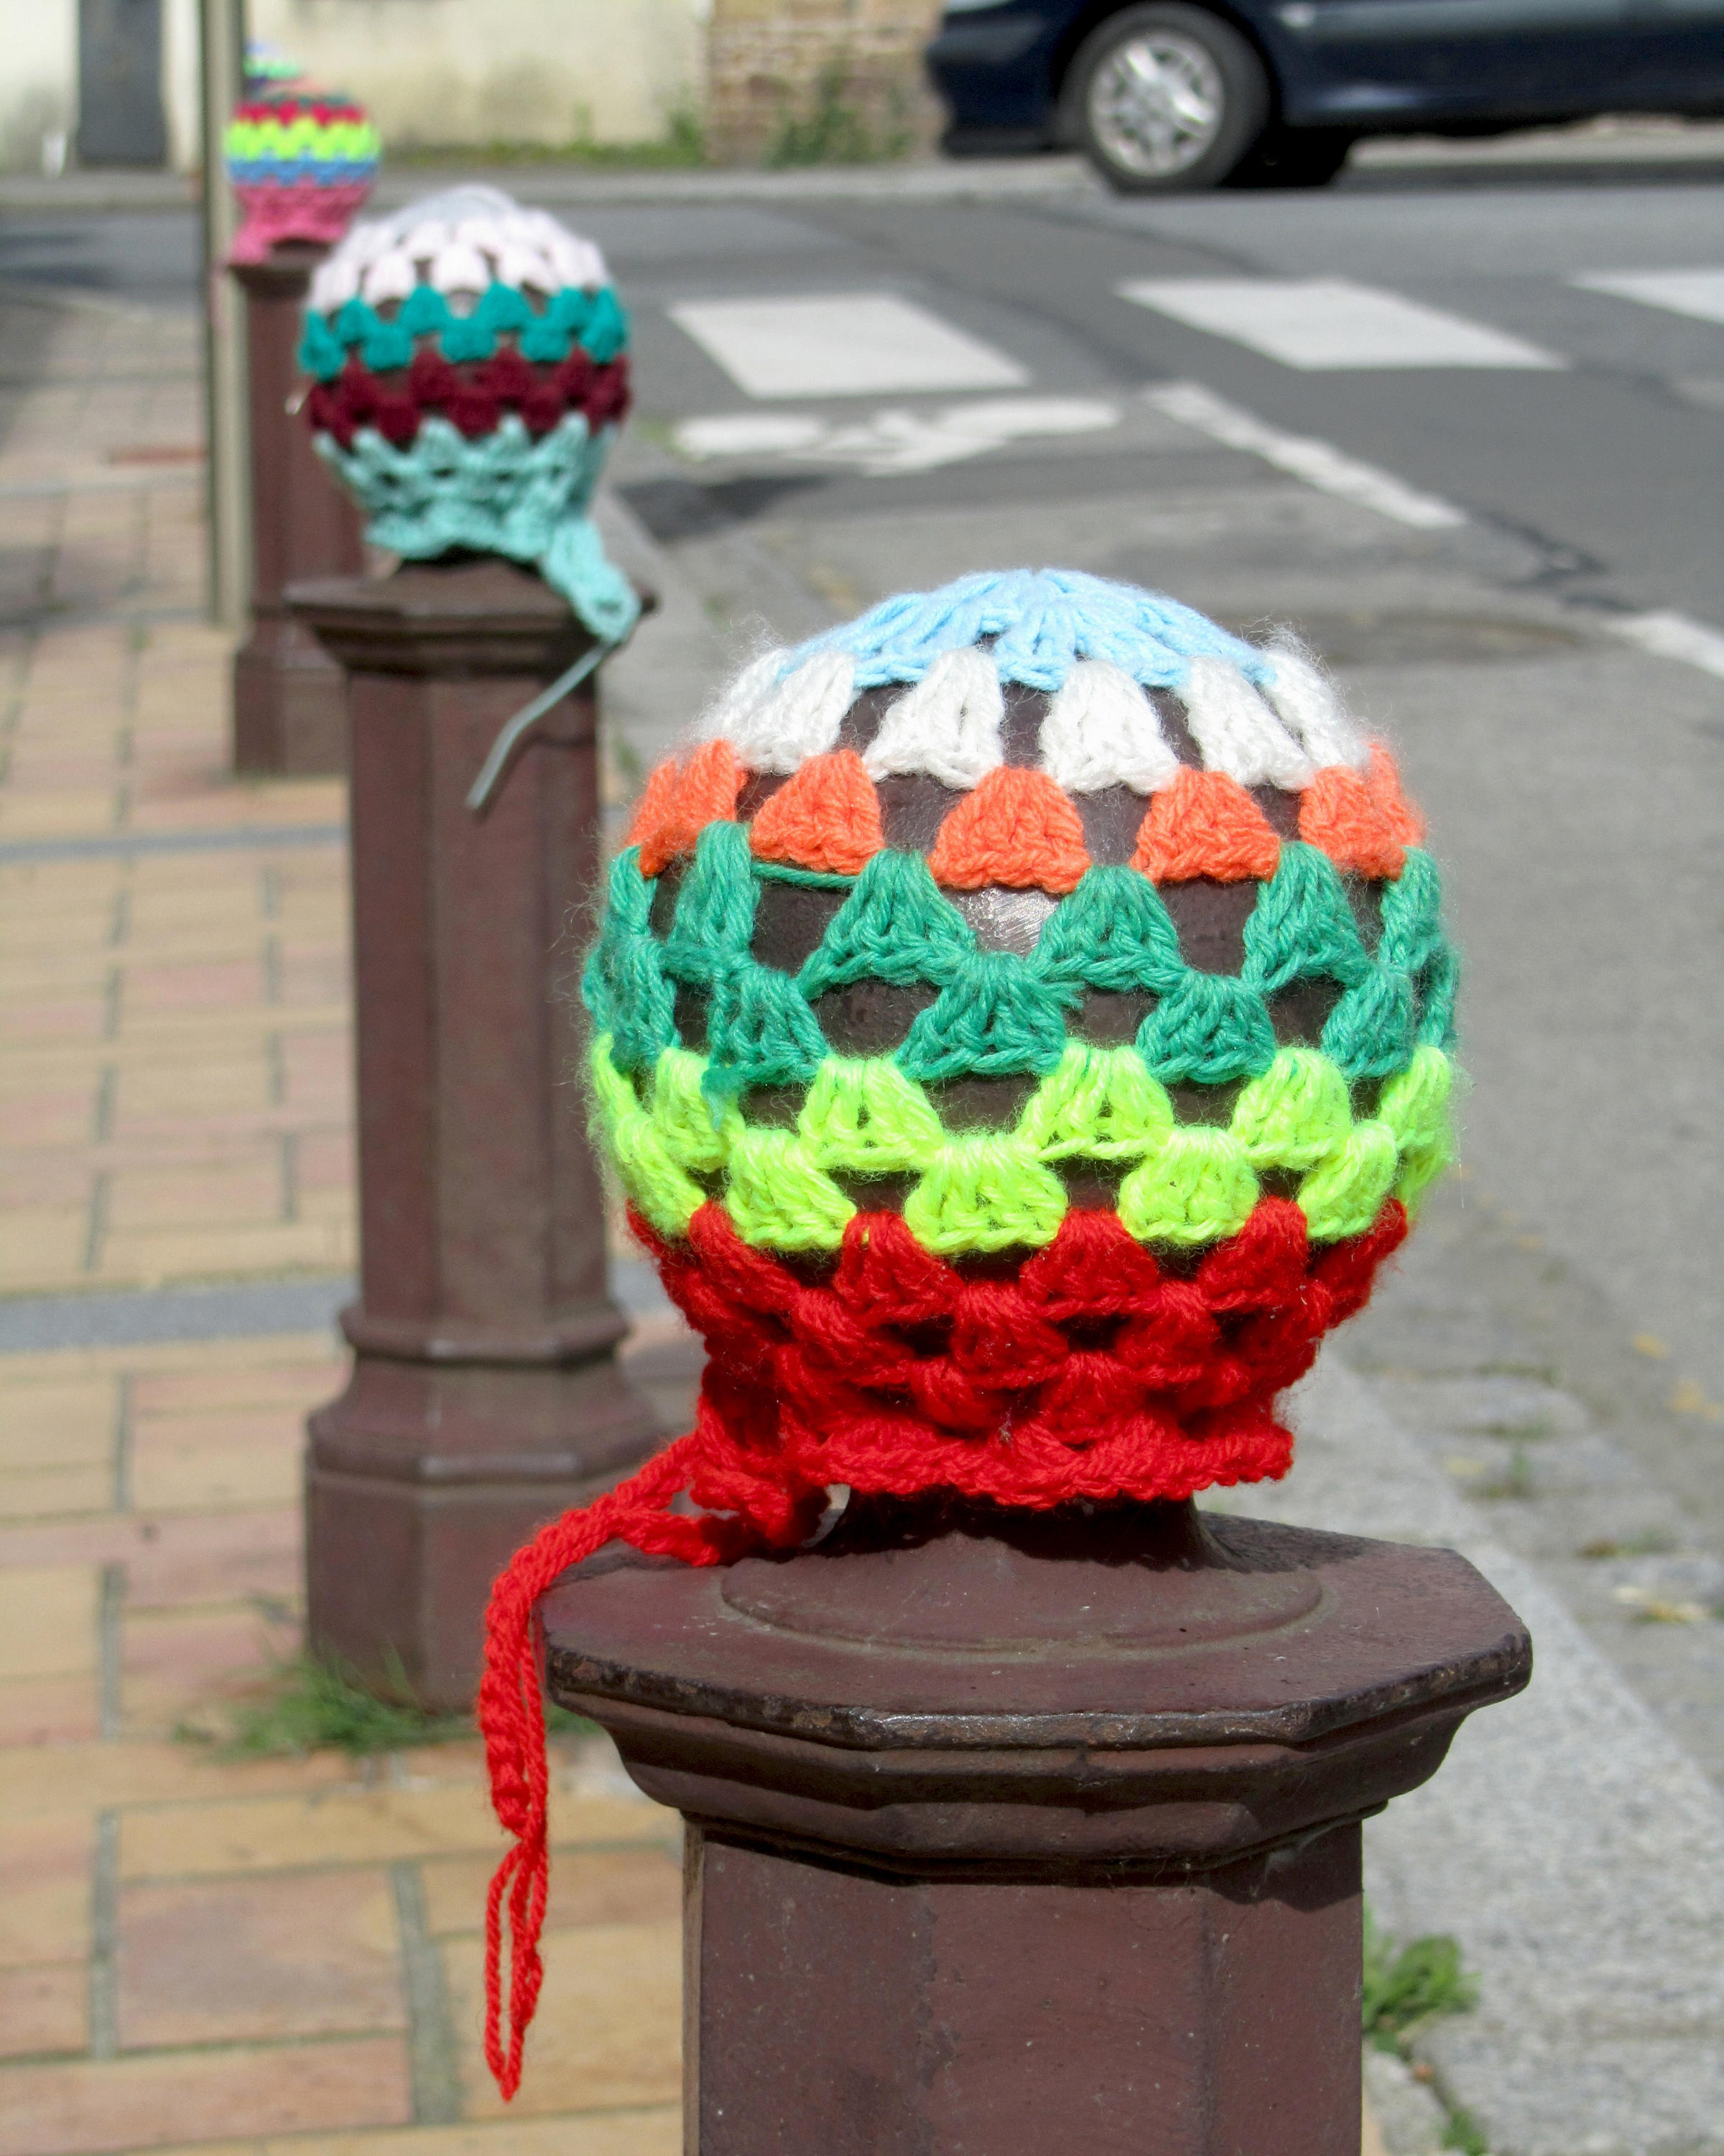
1.
Look at the pictures of Public Art in Zurich.
Name what you know and recognise. Use phrases like “I think this is …” or “I have seen …”
1. Urban-Knitting-Aktion (wikipedia) | 2 . Street Art, Zürich (own picture) | 3. Light Installation, Main Station Zurich (own picture) | 4. Heureka, Zurich Lake (wikimedia) | 5. Fountain, Zurich (own picture)
6. L’ange protecteur, Main Station Zurich (wikimedia) | 7. House balcony, Zürich (own picture) | 8. Street Art, Zürich (alamy) | 9. Church panel, Zürich (own picture) | 10. Urban-Knitting-Aktion (alamy)

Slide 4
2.
Look at the pictures again.
Copy this grid into your notebook.
For each category, write the names and picture numbers of the artworks.
Category: Forms of art | Pictures / Works of art
Graffiti
Sculpture
Yarnbombing
Mosaic
Patterns and shapes in architecture

Slide 5
3.
Read the texts below.
Match each text with the artwork from the pictures.
This is a fun kind of street art. Artists use wool to cover things like trees and posts with colourful scarves.
In 1964, Jean Tinguely made a big moving sculpture called "Heureka." It's made of iron bars, wheels, and metal pans and pipes. "Heureka" is located in a park on the Zurich Lake.
We can find this artwork in the Zurich Main Station. Bright lights move in circles on the ceiling. The lights make a pattern like an L.
Picture numbers:
In Zurich Main Station, there is a big colourful guardian angel. It is 11 meters tall and weighs 1.2 tonnes. The artist Niki de Saint Phalle made this sculpture.
Picture numbers:
Picture numbers:
Many buildings in Zurich have graffiti. Some are made by professional artists like the One Truth Crew, and others are done by young people who like to spray paint on walls. They create funny pictures and sometimes share a message.
Artworks in mosaic are pictures made of small, colourful pieces. They are like puzzles with tiny tiles. In Zurich, we can find them on fountains and other buildings.
Picture numbers:
In Zurich, lots of houses have balconies, doors, and windows with interesting patterns and shapes. These make them look pretty and artistic.
Picture numbers:
Picture numbers:
Picture numbers:

Slide 6

4.
Look at the pictures once again.
Choose one picture and say what you like/don’t like about it.
Example:
I like the bright colours in the graffiti. I like how they make the buildings look interesting and fun.
I like the colourful patterns on the tree. However, I don't like when yarnbombing covers too much of the tree's natural beauty

Slide 7
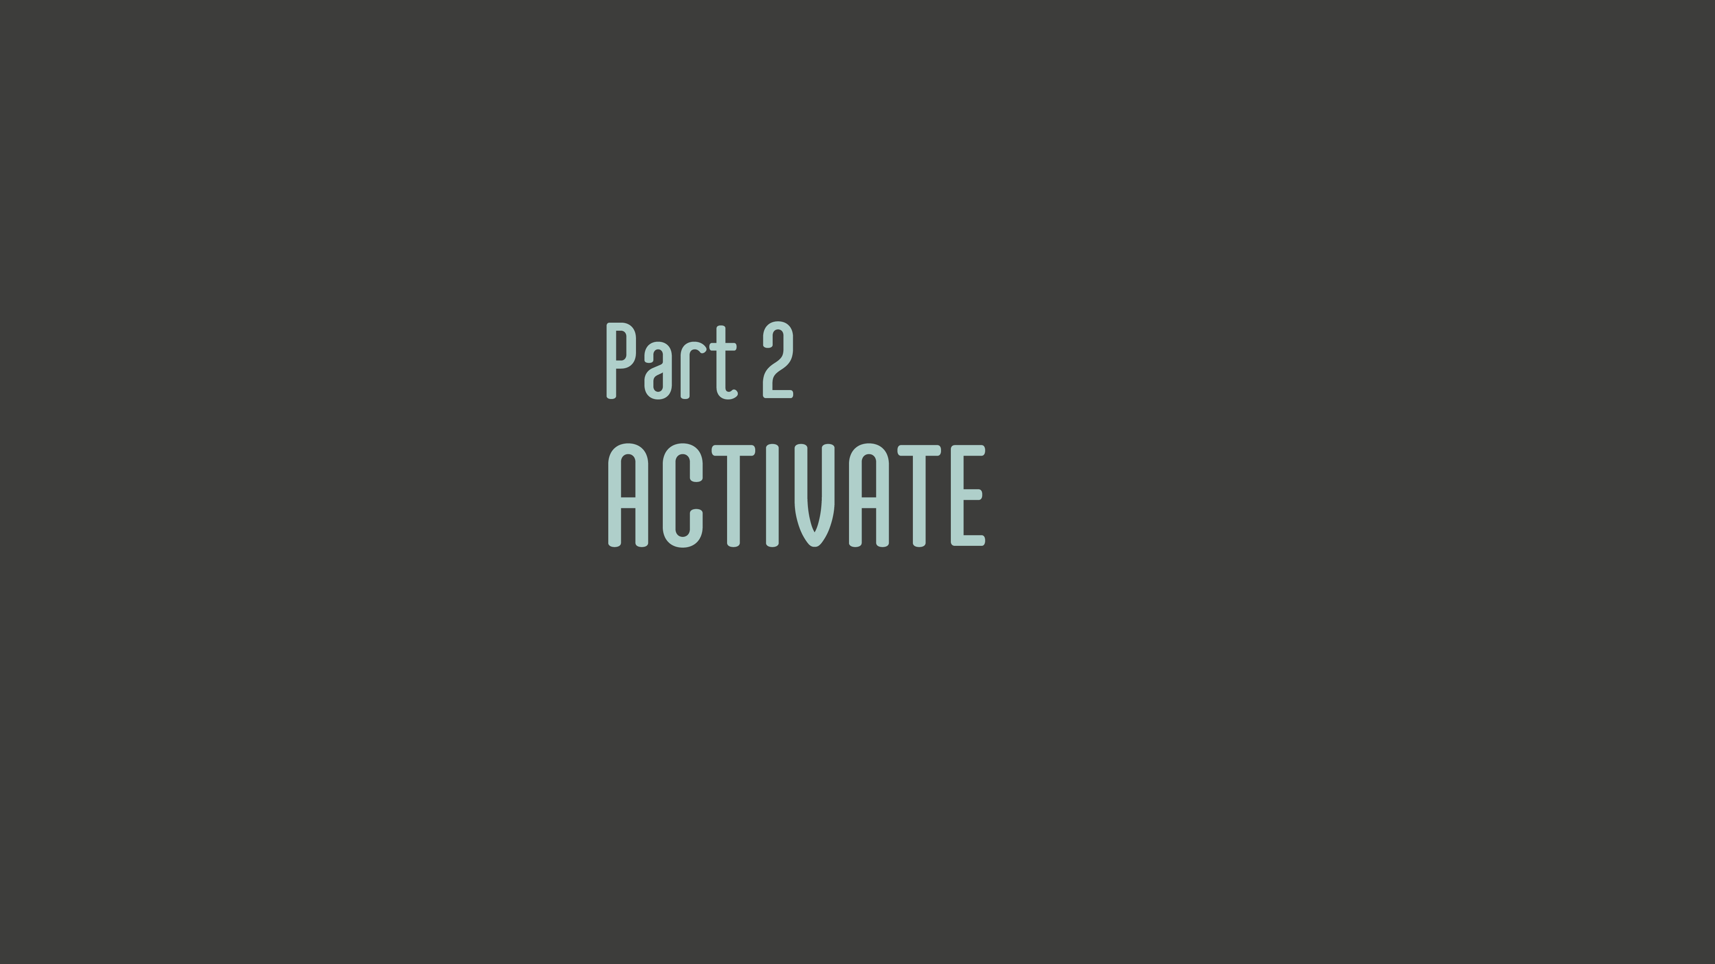

Slide 8
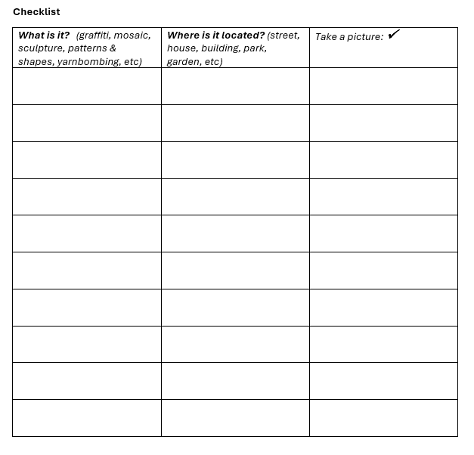
Go on a walk in your neighbourhood to find examples of public art on the streets, buildings, squares or parks.
Take 10 pictures of public art examples.
Use your phone or school iPad to take pictures of what you find.
Fill in the checklist as you go. Your teacher will give you this checklist.

Slide 9


Slide 10
Back in the classroom, select 4 or 5 pictures from the ones you took.
Create a ‘virtual art tour’ - a multimodal presentation using PowerPoint or Book Creator.
For each picture write a short text (see example).
Ask your teacher to correct your texts.
Rewrite the texts.
Record yourself reading the text for each picture.
Example:
There is a nice pattern on the metal bars of this balcony. The shapes all connect together. It makes the balcony look very pretty!

Slide 11


Slide 12
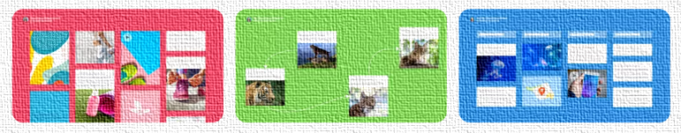
Share your multimedia presentation on a Padlet Wall or as a physical display (e.g. a hallway exhibition with QR codes).
Invite another class and your parents to look at your work.
Ask them to leave a comment.

